Slide 1
Lie with Data:
Unemployment Rates
Tania Ommer

Slide 2
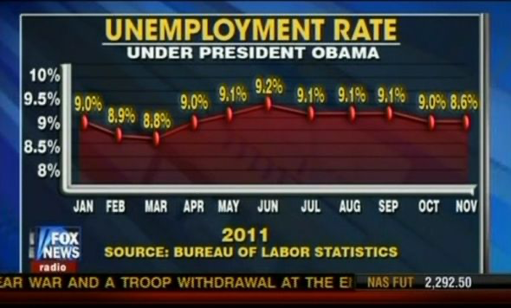
The Data
The plot on the left is from Fox News. It is designing to illustrate that after a small drop in unemployment, the rate continued to go up during the Obama administration.
Image Source: http://cloudfront.mediamatters.org

Slide 3
Why is this “Bad Data”?
The value for November is plotted incorrectly. It is supposed to be plotted with a y-axis value of 8.6%, but instead the point it at the same level as 9.0%.
They presented it as 8.6% but plotted it higher to make it appear as though the unemployment rate did not drop in the month of November.

Slide 4
Why is this “Bad Data”? (continued)
The overall data has been plotted to look like there is an exponential growth in the unemployment rate.
However, the overall employment trend is pretty stable, as the rate for every month is around 9%.
The way the data is plotted, it is difficult to identify the stability in the rates.

Slide 5
Why would they use the data this way?
Fox News’s goal of creating “bad data” of the unemployment rates is to purposely misleading viewers into believing that the unemployment rate experienced exponential growth under the Obama administration
By plotting points incorrectly and presenting the stable data as exponential, viewers would think that Obama’s presidency caused a greater unemployment rate, ultimately leading them to support Obama’s opponent
Generating “bad data” like this can be used as political propaganda to aid in individuals campaigns and make them appear more productive in the public’s eye

Slide 6
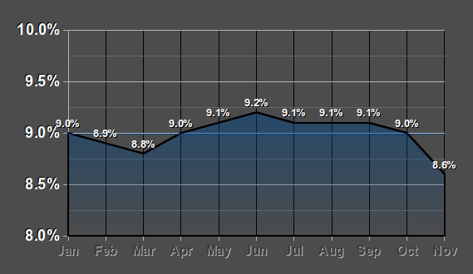
What it should look like:
This is a depiction of what the unemployment rate graph should look like.
The data point for November is correctly plotted at 8.6%, showing the drop from October.
The overall trend of unemployment rates are stable, with the middle of the graph showing consistently similar values.
The graph no longer appears to show an exponential trend.

